Slide 1



PhD ENACT day – Thursday, October 8, 2026 – Louis Ducongé
Patient-specific balloon design for angioplasty by shape optimization
Thesis advisors:
MIMESIS, Strasbourg : Stéphane Cotin, Michel Duprez, Raphaël Bulle
SPHINX, IECL, Nancy : Yannick Privat
Links pictures:
- Logo IECL : https://iecl.univ-lorraine.fr/presentation-du-nouveau-logo-de-linstitut-elie-cartan-de-lorraine-%F0%9F%91%80/https://iecl.univ-lorraine.fr/presentation-du-nouveau-logo-de-linstitut-elie-cartan-de-lorraine-%F0%9F%91%80/
- Logo Inria : https://www.inria.fr/fr/charte-dutilisation-de-lidentite-visuelle-dinria
- Logo MIMESIS : https://mimesis.inria.fr/

Slide 2
Context – Patient specific balloon design.
Deposit on the artery wall: Stenosis¹.
A known treatment: Angioplasty (balloon)¹.
Balloon
Before
Artery
After
Deposit
¹ [Martin et al., 2010], [Morlacchi et al., 2013], [Pan et al., 2021].
Links pictures:
No picture for the moment.

Slide 3
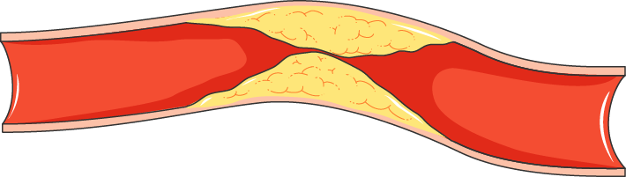
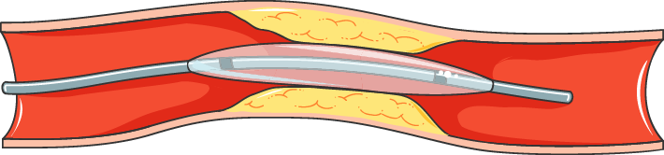
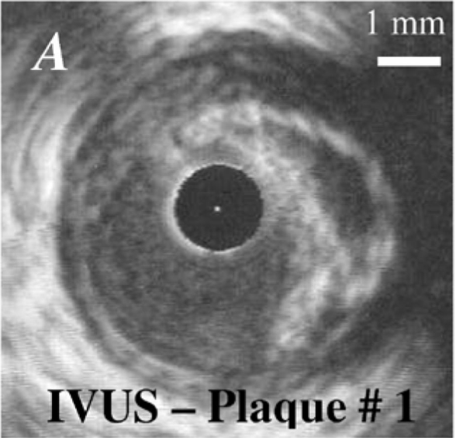
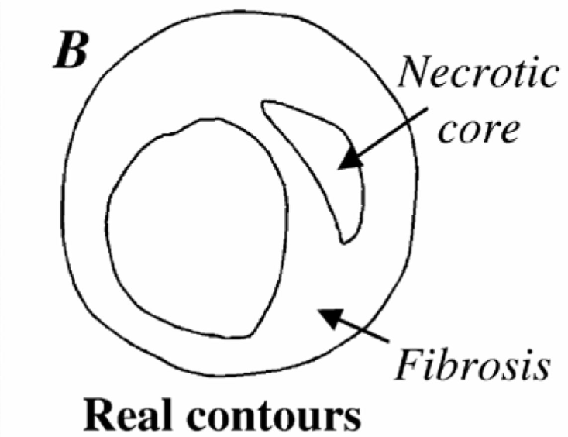
Context – Patient specific balloon design.
Current approach: Symmetric balloon (cylinder)¹.
Problem: the stenosis is not symmetric, it depends on the patient
(geometry of the artery, properties of the plaque of lipids, heterogeneity of the arterial wall...)
Objective: Designing balloons that are better tailored to patient.
¹ [Antonini et al., 2023].
Picture: [Le Floc’h et al., 2009].
Links pictures:
- Artery and plaque (first image): https://commons.wikimedia.org/wiki/File:Cardiovascular_system_-_Angioplasty_2_--_Smart-Servier.png
- Balloon in artery (second image): https://commons.wikimedia.org/wiki/File:Cardiovascular_system_-_Angioplasty_3_--_Smart-Servier.png
- The last pictures in the lower right corner: https://ieeexplore.ieee.org/document/4752741

Slide 4
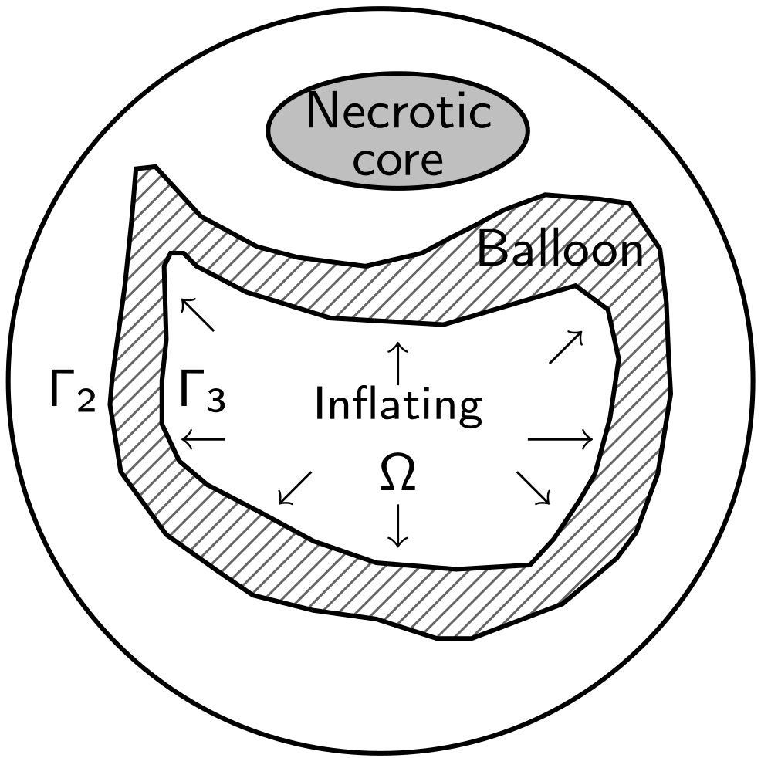
Balloon problem: modeling.
Goal: Ease the blood flow by adapting the thickness of the balloon.
Our approach: Optimize Γ3 such that after inflating and deflating the balloon, Γ2 ≈ circle
using shape optimization via level-set method¹.
Artery + plaque
(elastoplastic)
¹ [Osher, Sethian, 1988].
Links pictures:
- Artery: / (created)

Slide 5
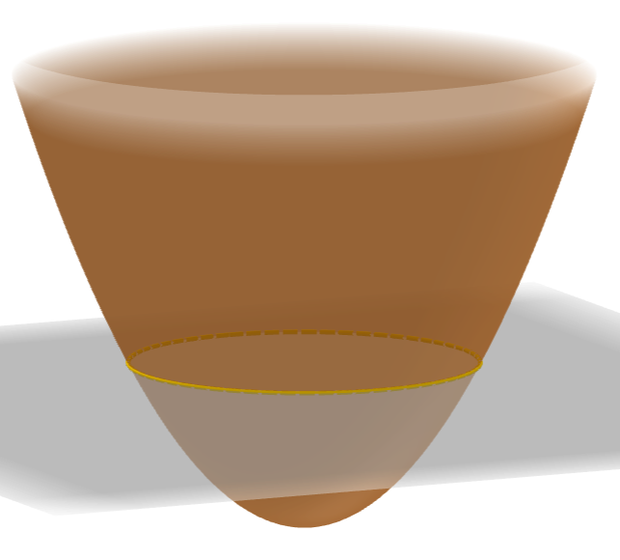
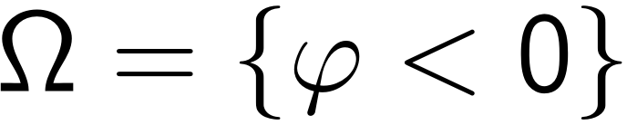
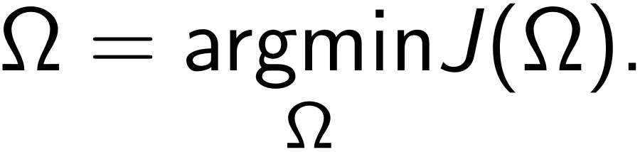
Level-set algorithm.¹
Ansatz: .
Goal: If J is a cost function, calculate
Algorithm: Gradient descent.
Steps:
Computation of J(Ω): state equations.
Computation of the shape derivative.
Computation of an admissible perturbation.
Update Ω by updating φ.
¹ [Allaire et al., 2004].
Links pictures:
- Level-set: GeoGebra https://www.geogebra.org/m/vtezcvqu

Slide 6
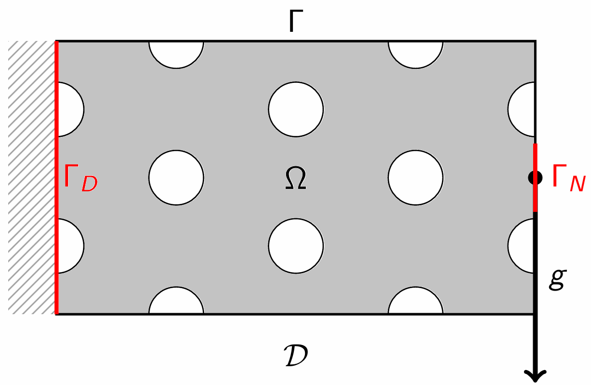
Toy model: Cantilever beam.¹
Goal:
For a fixed volume, find a structure Ω providing the best possible resistance when subjected to a force g.
Cost functional: Compliance.
¹ [Allaire et al., 2004], [Laurain, 2018].
Links pictures:
- Cantilever: / (created)

Slide 7
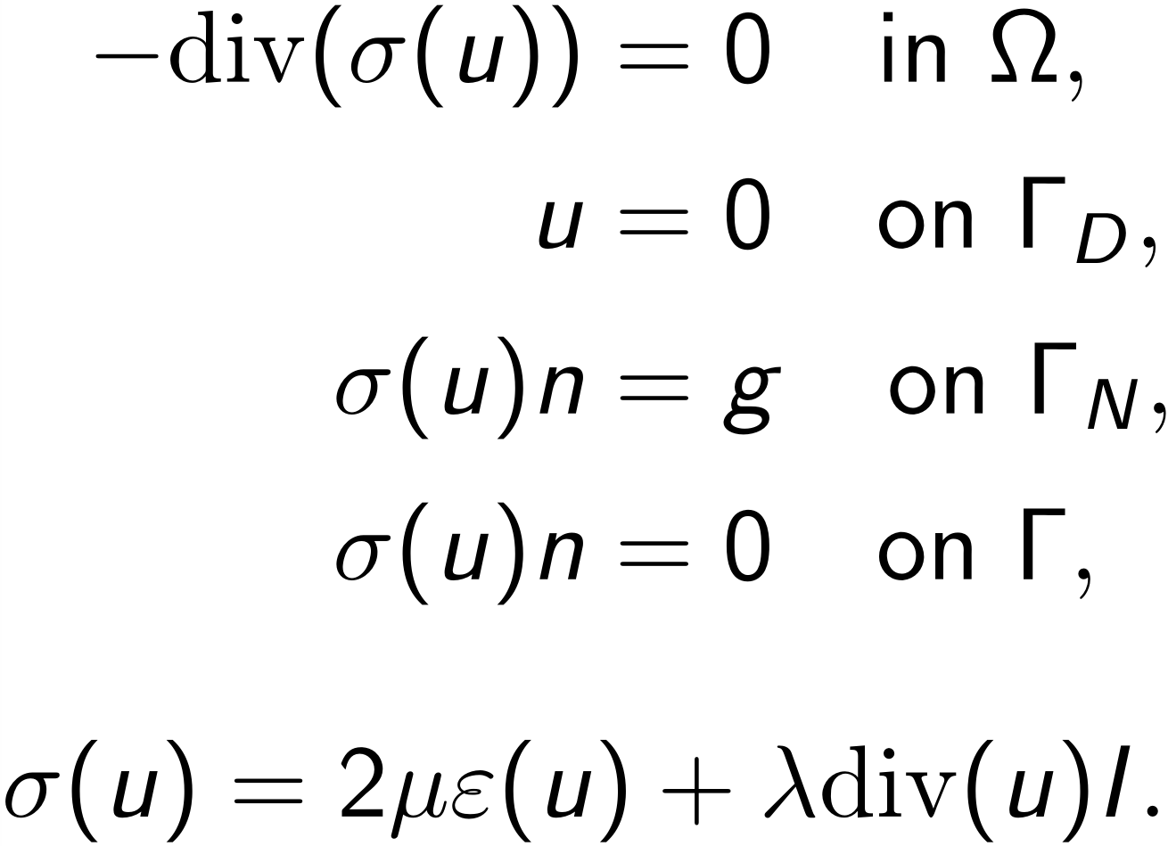
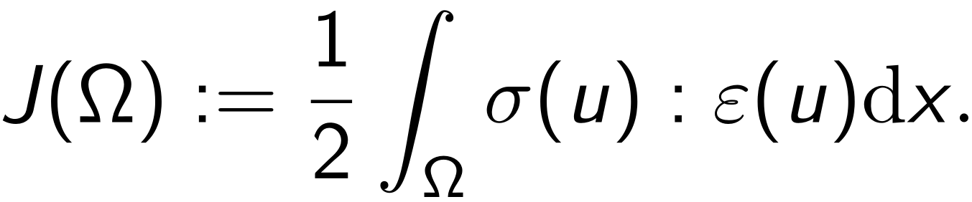
Toy model: Cantilever beam.
Step 1: Computation of the cost function.
State equations:
Cost function:
Numerical scheme: φ-FEM¹ (use of level-set).
¹ [Duprez et al., 2020].
Links pictures:
- Cantilever: / (created)

Slide 8
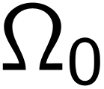
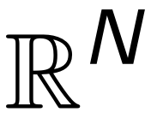

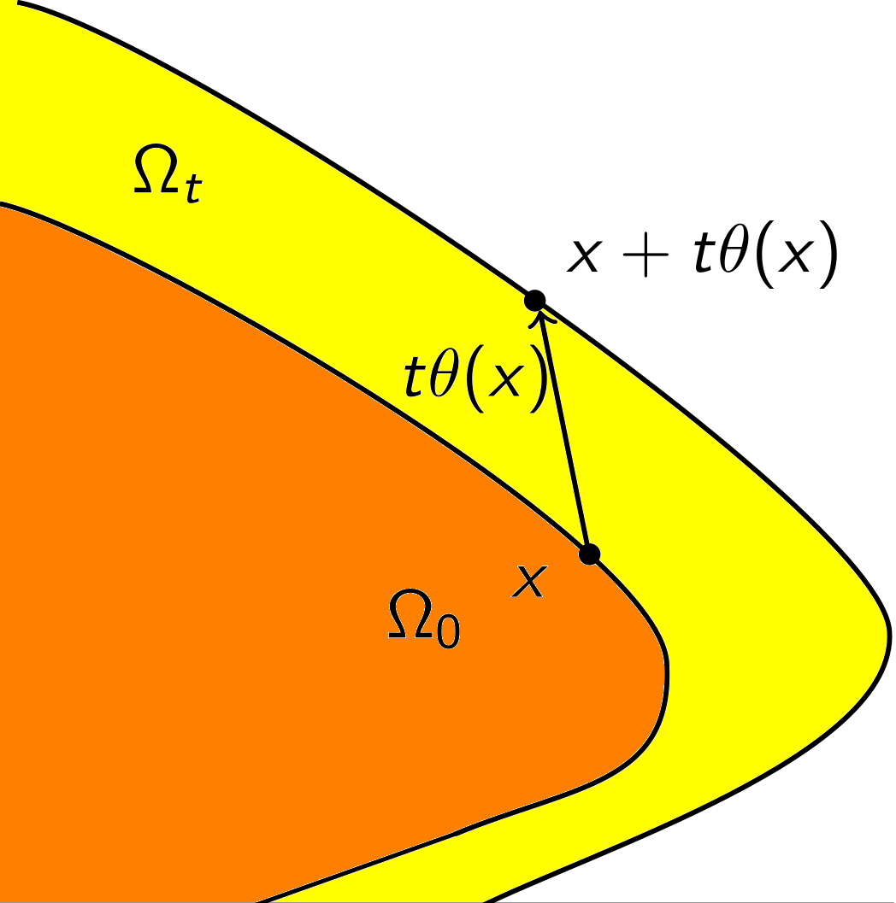
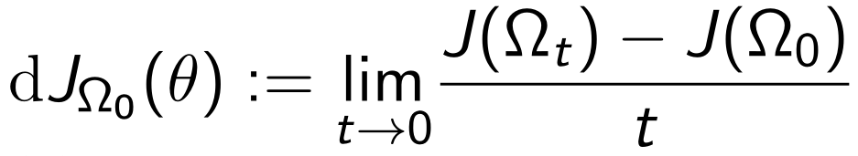
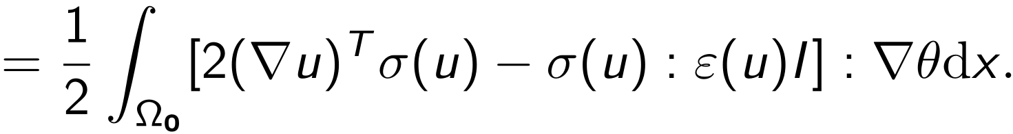
Toy model: Cantilever beam.
Step 2: Shape derivative.¹
Let be a bounded domain of and a vector field (perturbation).
²
¹ [Allaire, 2007], [Delfour, Zolésio, 2011].
² [Allaire et al., 2004], [Laurain, 2018].
Links pictures:
- Mathematical diagram: / (created)

Slide 9
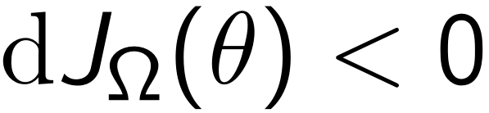
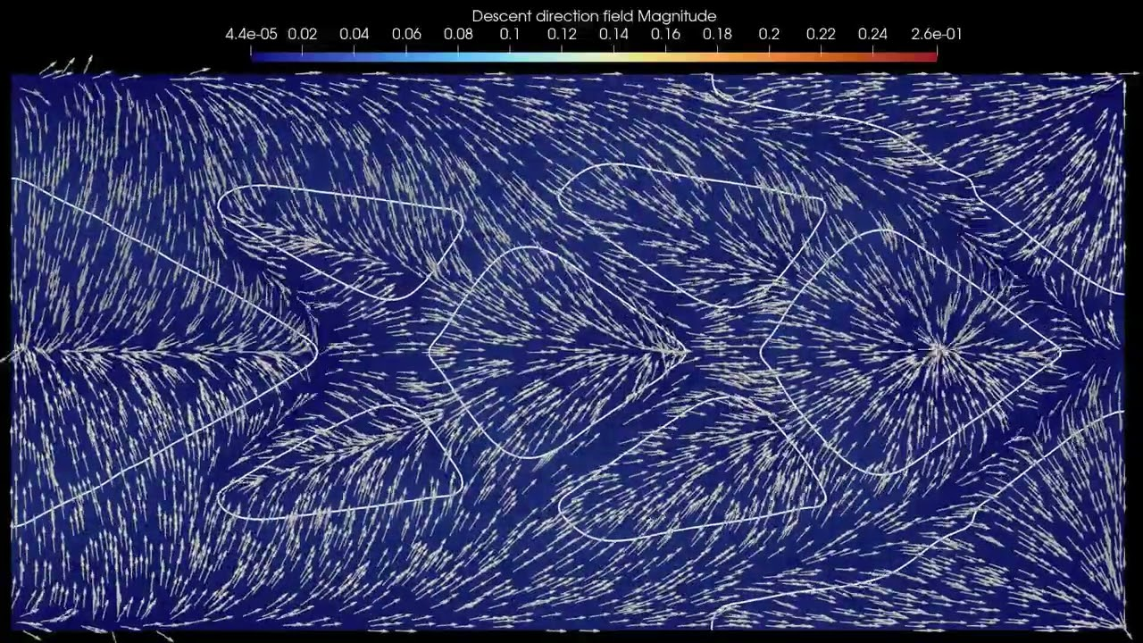



Toy model: Cantilever beam.
Step 3: Computation of the perturbation.
Gradient descent:¹ for a given Ω,
find (perturbation) such that:
Calculation using finite elements (FE).
²
Video from R. Bulle.
¹ [Allaire et al., 2004].
² [Burger, 2003].
Links pictures:
No picture for the moment.
Link of the video (R. Bulle): https://youtu.be/8cLXBA13dCU
Click on the picture to open the video on YouTube!
(in presentation mode)

Slide 10
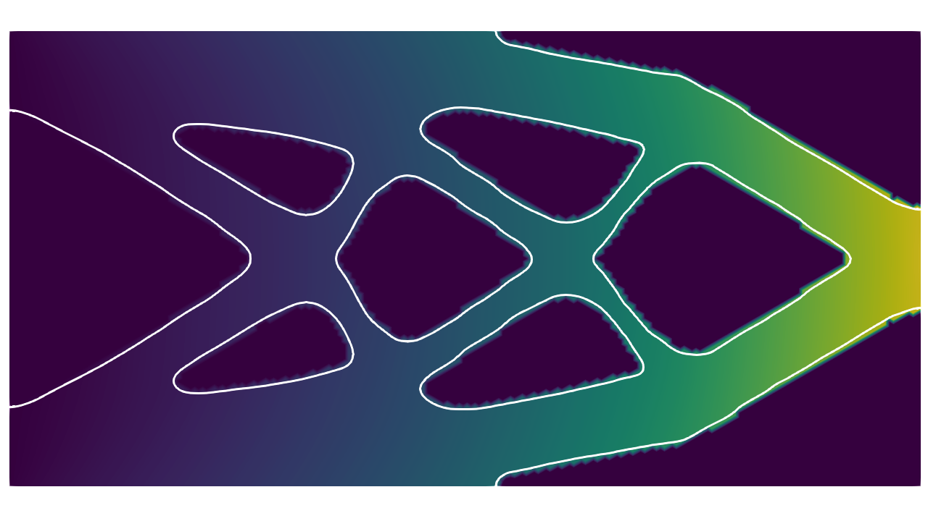
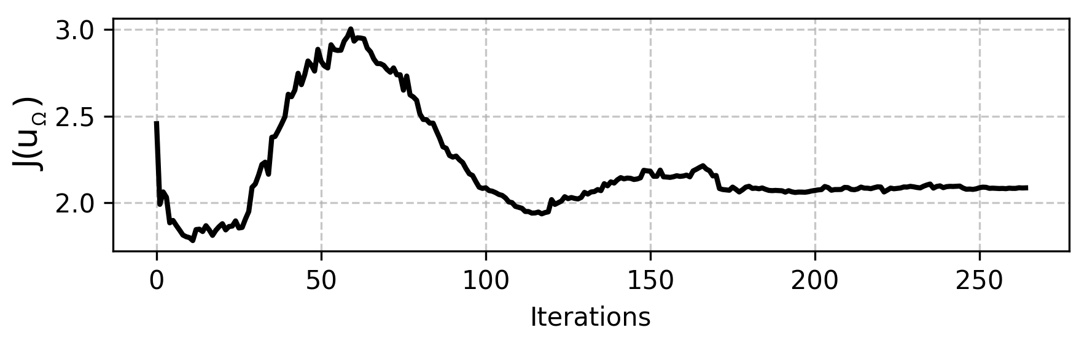
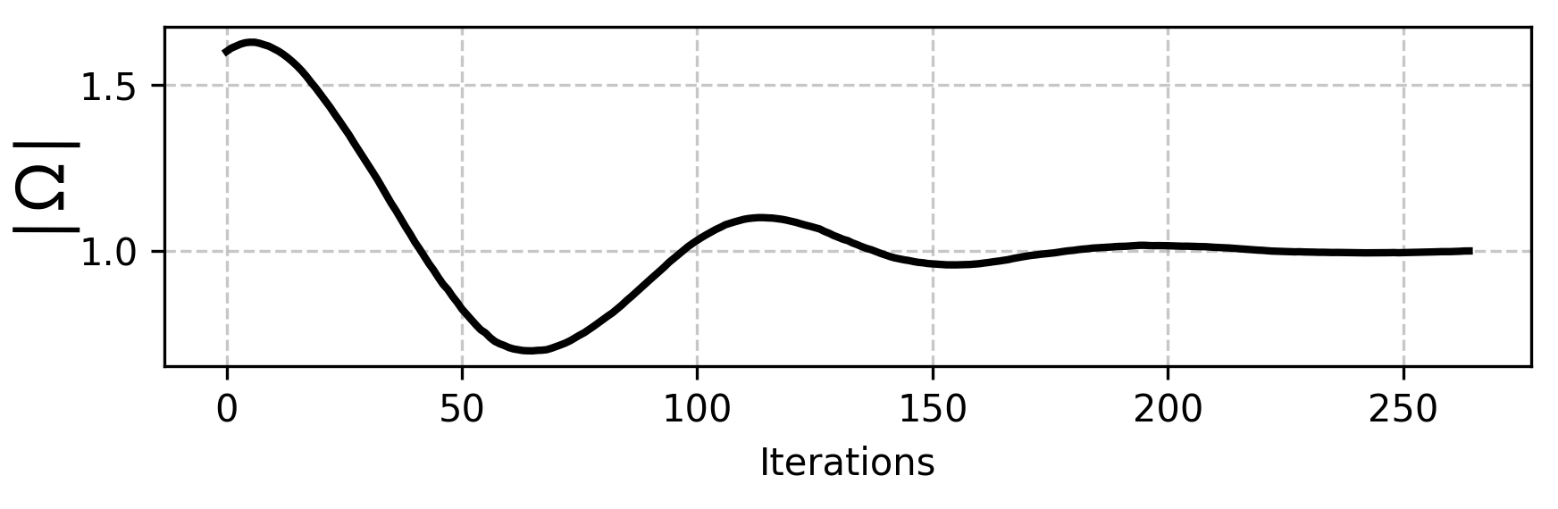
Toy model: Cantilever beam.
Result.¹
Evolution of the cost function:
Evolution of the volume:
Video from R. Bulle.
¹ Use of FormOpt: [Díaz-Avalos, Laurain, 2026]
Links pictures:
No picture for the moment.
Link of the video (R. Bulle): https://youtu.be/Mm4J84AA4WU
Click on the picture to open the video on YouTube!
(in presentation mode)
Link of FormOpt deposit (Github): https://github.com/JD26/FormOpt

Slide 11
AI perspectives.
In the shape optimization algorithm:
States and perturbation: training a neural network (reducing cost).
Existing work with φ-FEM-FNO: [Duprez et al., 2025].
Neural network within the shape optimization loop: [Wang et al., 2024].
Computation of J(Ω) (hard for the cantilever, worse for the balloon :
more expensive, nonlinear equations…).
Parameters of the optimization algorithm.
Several at once?
In the balloon problem:
Patient geometry as input.
Links pictures:
No picture for the moment.

Slide 12
Additional slides
Links pictures:
No picture for the moment.

Slide 13
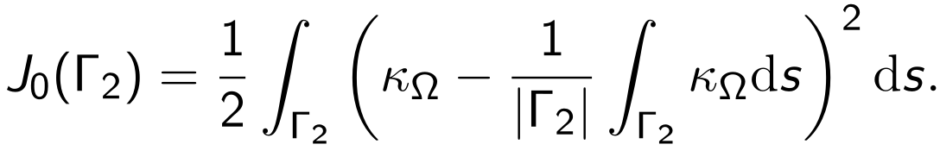

Functional to minimize – Balloon problem.
Curvature variance:
We minimize:
Artery + plaque
(elastoplastic)
Willmore functionals: see e.g. [Dogan, Nochetto, 2012].
Links pictures:
- Artery: / (created)

Slide 14
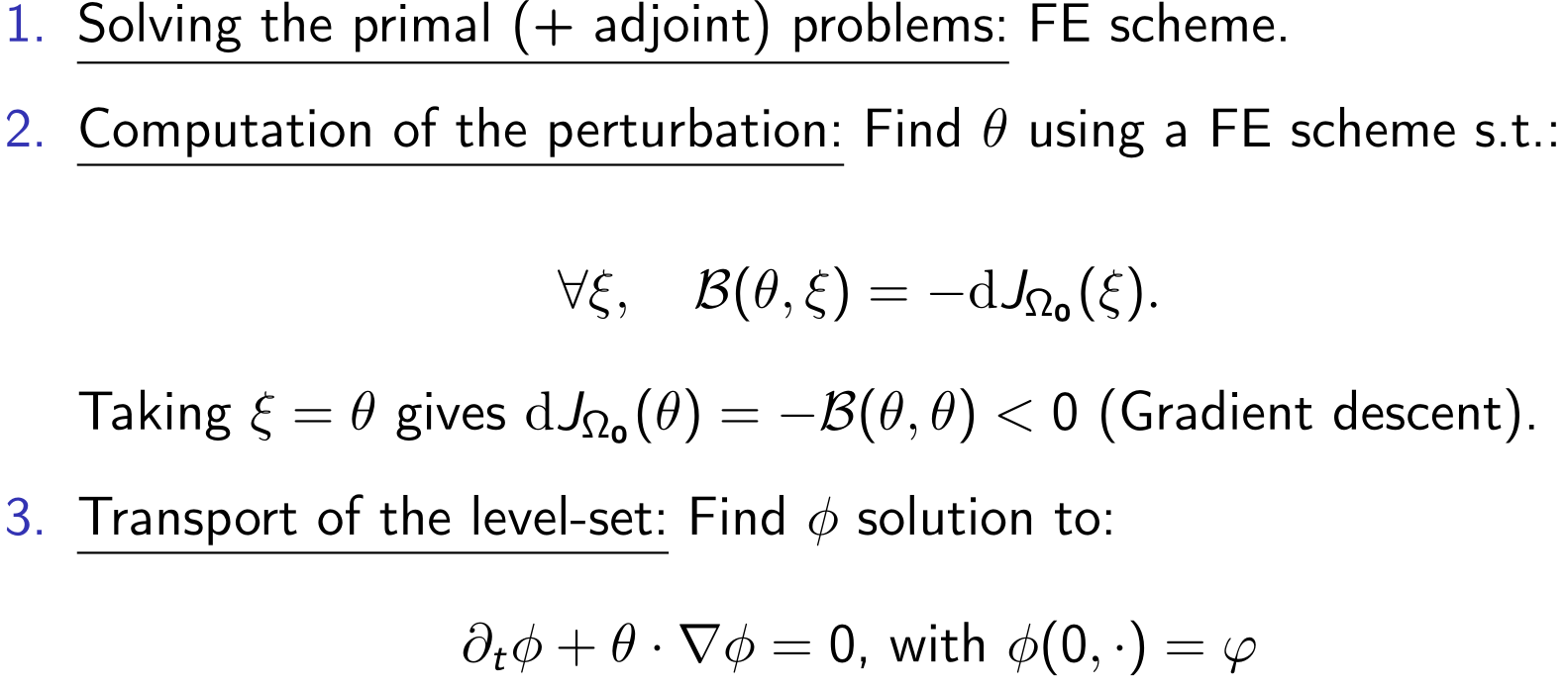
Complete shape optimization algorithm.
[Osher, Sethian, 1988], [Burger, 2003], [Allaire et al., 2004].
Links pictures:
No picture for the moment.

Slide 15
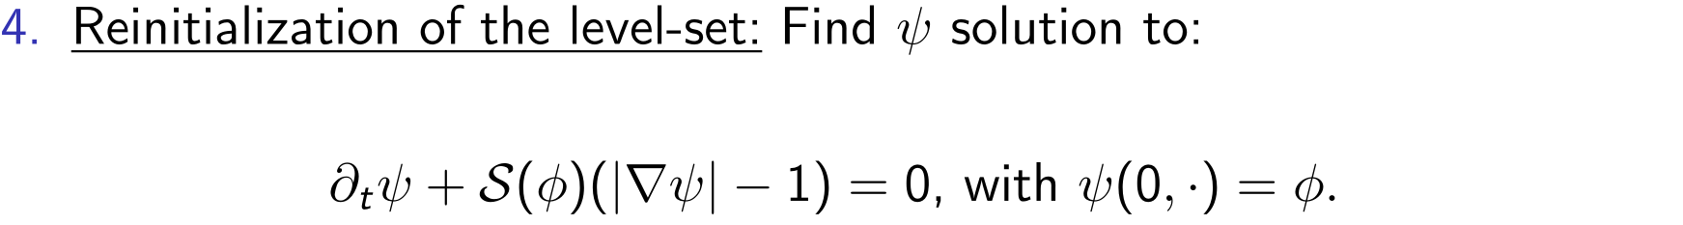
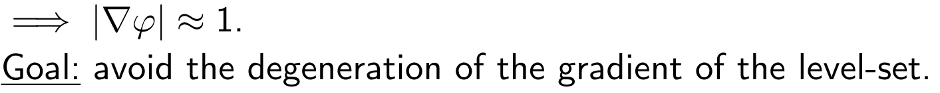
Addition to the algorithm: the reinitialization.
[Osher, Sethian, 1988], [Burger, 2003], [Allaire et al., 2004].
Links pictures:
No picture for the moment.

Slide 16
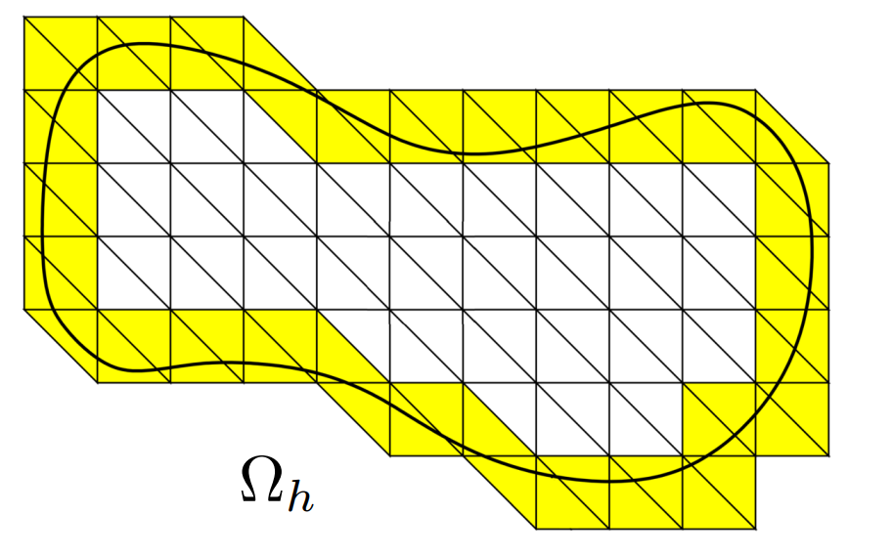
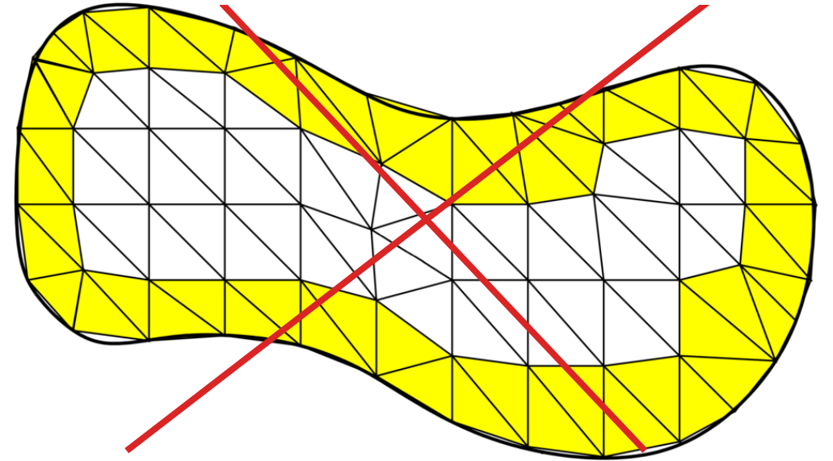
Immersed boundary methods.
Fitted mesh.
Unfitted mesh.
Remeshing at every iteration not necessary.
→ Suitable for shape optimization problems and the level-set method.
Our approach: φ-FEM [Duprez et al., 2020].
Other approaches: XFEM [Moes et al., 1999], CutFEM [Burman, Hansbo, 2014]…
Immersed boundary methods: [Saul’ev, 1963], [Glowinski et al., 1964a].
Links pictures:
- 2 images with meshes: https://michelduprez.fr/assets/uploads/2023/09/phifem_enumath_2023.pdf

Slide 17
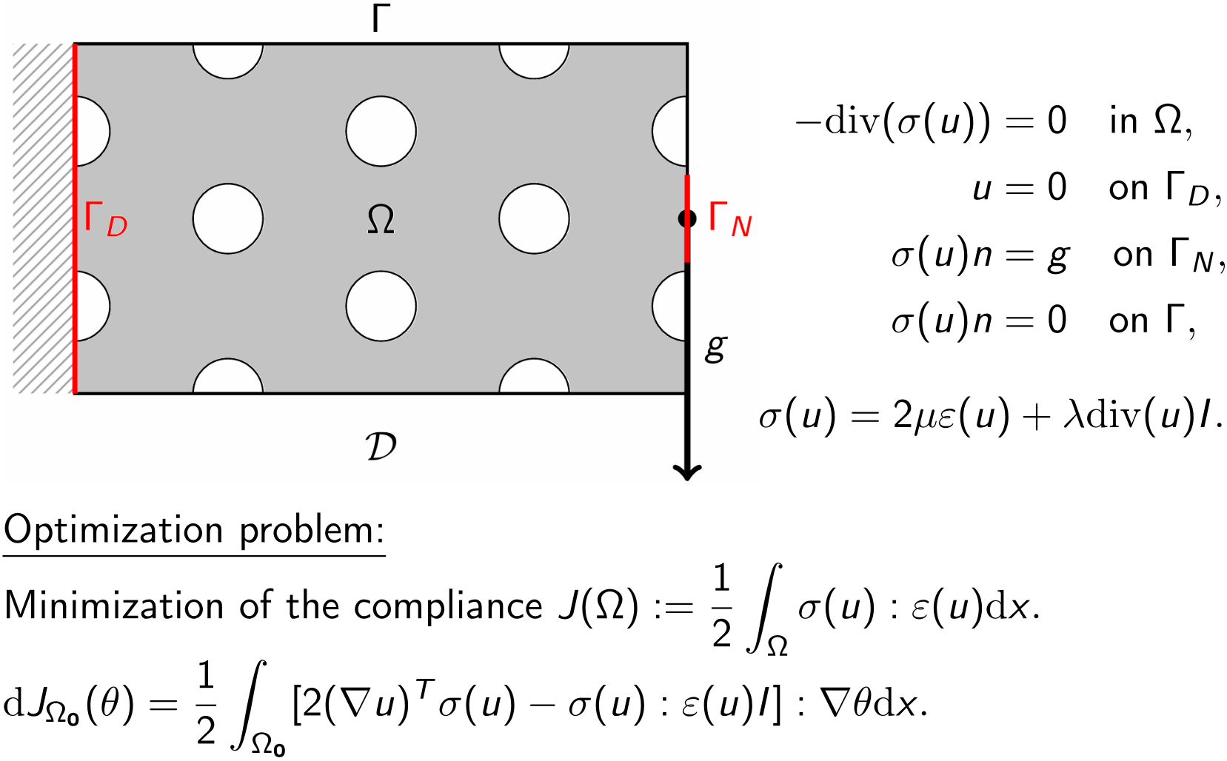
Cantilever beam: cost functional.
See e.g. [Laurain, 2018], [Burman et al., 2018], [Díaz-Avalos, Laurain, 2026].
Links pictures:
- Cantilever: / (created)

Slide 18
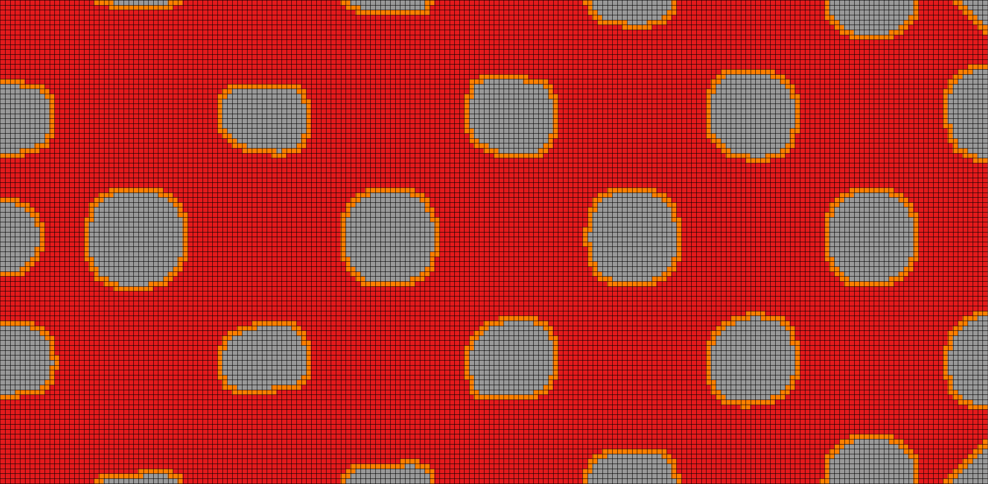
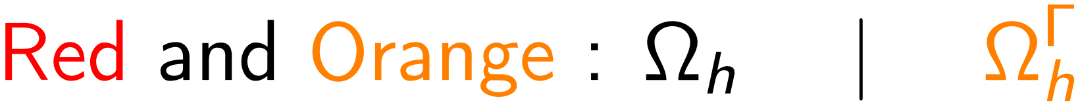
Cantilever beam: φ-FEM formulation (1/3).
Links pictures:
- Mesh: no link (from R. Bulle)

Slide 19
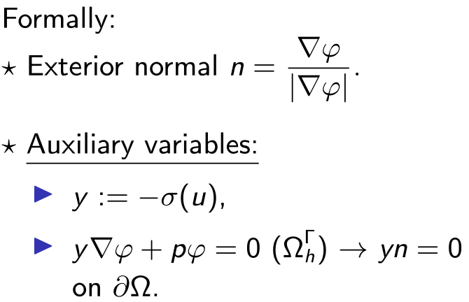
Cantilever beam: φ-FEM formulation (2/3).
Links pictures:
- Mesh: no link (from R. Bulle)

Slide 20
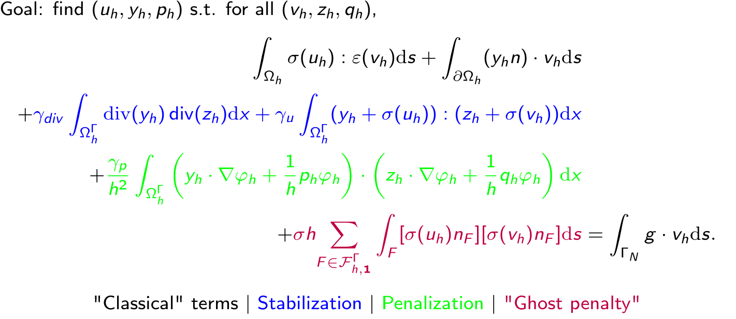
Cantilever beam: φ-FEM formulation (3/3).
See [Duprez et al., 2022], [Cotin et al., 2023], [Bulle et al., 2026].
Links pictures:
No picture for the moment.

Slide 21
Sources of the multimedia content.
Slide 3: Laboratoires Serviers (first two pictures) - Wikimedia Commons.
Links: Picture 1: Artery with plaque ; Picture 2: Artery with balloon.
Slide 3: [Le Floc’h et al., 2009] (lower right corner of the slide).
Link: Picture: Artery with plaque (x2).
Slide 5: GeoGebra (creation from me).
Link: Picture: Level-set example.
Slides 10, 18 and 19: R. Bulle.
Slide 16: M. Duprez (φ-FEM presentation).
Link: Presentation of φ-FEM.
Slides 9 and 10: Videos from R. Bulle.
Links: Video of Slide 9: Gradient descent; Video of Slide 10: Cantilever result.
Other pictures are not referenced (see under the relevant slides).
Links pictures:
No picture for the moment.

